Slide 1
Oops with java presentation…

Slide 2
Introduction to Java Records
What is a Record? :-
Introduced in Java 14 as a preview feature, officially released in Java 16.
A special kind of class designed to hold immutable data.
Automatically generates the boiler plate code such as constructors , getters , equals(), hasCode() and toString() method.

Slide 3


Syntax and example code
Basic syntax:-
Example- Suppose we make a record named person with 2 parameters:-
The automatically generated methods for the given record will be:-
public String name() public boolean equals(Object o) public String toString()
public int age() public int hashCode()

Slide 4
Benefits and limitations of using records
benefits
limitations
Immutability
  Fields are final and cannot be changed after creation.
Boilerplate Reduction
  No need to manually write common methods.
Improved Readability
  Clear and concise representation of data.
No Inheritance
  Records cannot extend other classes (but can implement interfaces).
Immutability Constraints
  All fields are final and cannot be reassigned.
Suitability:
  Best for simple data-carrying classes, not for complex business logic.

Slide 5
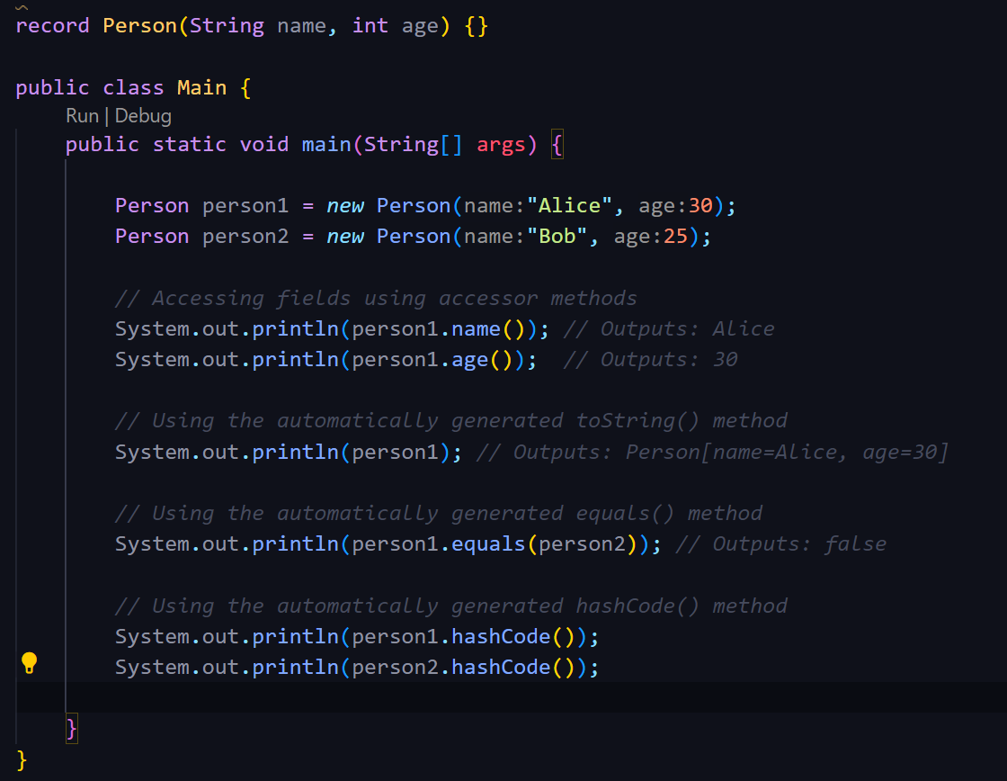
Lets see the working of a record
As we can see after declaring the
Record “Person”, how different methods
Gets automatically generated by the
Compiler and there usage.

Slide 6
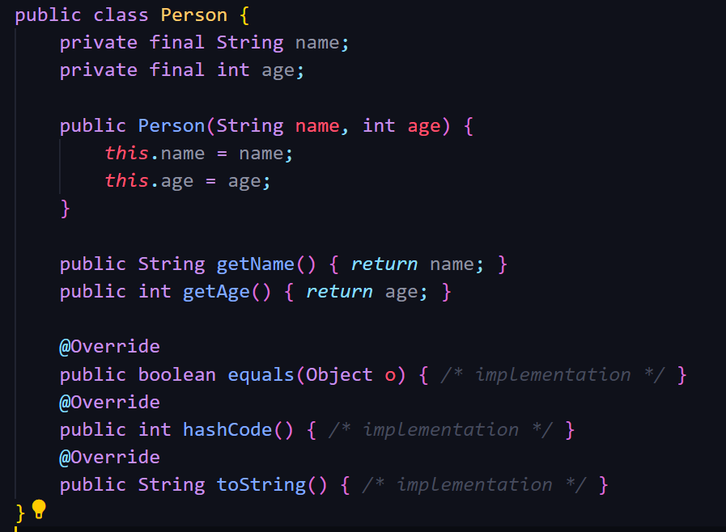

Record vs no record??
What’s the difference?
Literally one liner
Your hard work right here….

Slide 7
Some practical use cases of records:-
DTOs (Data Transfer Objects)
  Simplifies the creation of objects used to transfer data between layers.
Value Objects
  Ideal for objects that represent a fixed set of data, such as coordinates, points, etc.
Configuration Objects
  Can be used to store configuration settings that do not change.

